Slide 1

Working with Java Script Executor

Slide 2
Introduction
JavaScriptExecutor is an Interface that helps to execute JavaScript through Selenium Webdriver.
JavaScriptExecutor provides two methods to run javascript on the selected window or current page are:-
1) executeAsyncScript:-This function will execute an asynchronous piece of JavaScript in the context of the currently selected frame or window in Selenium. The JS so executed is single-threaded with a various callback function which runs synchronously.
2) executeScript:-This method executes JavaScript in the context of the currently selected frame or window in Selenium. The script used in this method runs in the body of an anonymous function (a function without a name). We can also pass complicated arguments to it. where :-
Script –This is the JavaScript that needs to execute.
Arguments – It is the arguments to the script.
It's optional.
JavascriptExecutor js = (JavascriptExecutor) driver; js.executeScript(Script,Arguments);

Slide 3
A sleep in the browser under test operation performed by ”executeAsyncScript” Method
Step 1) Capture the start time before waiting for 5 seconds ( 5000 milliseconds) by using executeAsyncScript() method.
Step 2) Use executeAsyncScript() to wait 5 seconds.
Step 3) Get the current time.
Step 4) Subtract (current time – start time) = passed time.
Step 5) Verify the output it should display more than 5000 milliseconds.

Slide 4
Now See the code here:-
import java.util.concurrent.TimeUnit;
import org.openqa.selenium.JavascriptExecutor;
import org.openqa.selenium.WebDriver;
import org.openqa.selenium.firefox.FirefoxDriver;
import org.testng.annotations.Test;
public class JavaSE_Test {
@Test
public void Login() {
WebDriver driver= new FirefoxDriver();
//Creating the JavascriptExecutor interface object by Type casting
JavascriptExecutor js = (JavascriptExecutor)driver;
//Launching the Site.
driver.get(URL);
//Maximize window
driver.manage().window().maximize();

Slide 5
//Set the Script Timeout to 20 seconds
driver.manage().timeouts().setScriptTimeout(20, TimeUnit.SECONDS);
//Declare and set the start time
long start_time = System.currentTimeMillis();
//Call executeAsyncScript() method to wait for 5 seconds js.executeAsyncScript("window.setTimeout(arguments[arguments.length - 1], 5000);");
//Get the difference (currentTime - startTime) of times. System.out.println("Passed time: " + (System.currentTimeMillis() - start_time));
}
}

Slide 6
OUTPUT:-
TestNG] Running:
C:\Users\gaur\AppData\Local\Temp\testng-eclipse-387352559\testng-customsuite.xml
log4j:WARN No appenders could be found for logger (org.apache.http.client.protocol.RequestAddCookies).
log4j:WARN Please initialize the log4j system properly.
log4j:WARN See http://logging.apache.org/log4j/1.2/faq.html#noconfig for more info.
Passed time: 5022
PASSED: Login
===============================================
Default test
Tests run: 1, Failures: 0, Skips: 0
===============================================

Slide 7
Scroll Down operation performed by ”executeScript” Method
Step 1) Launch the site.
Step 2) Scroll down by 600 pixel.
Now see the code here:-
import org.openqa.selenium.JavascriptExecutor;
import org.openqa.selenium.WebDriver;
import org.openqa.selenium.firefox.FirefoxDriver;
import org.testng.annotations.Test;
public class JavaSE_Test
{
@Test
public void Login()
{
WebDriver driver= new FirefoxDriver();

Slide 8
//Creating the JavascriptExecutor interface object by Type casting
JavascriptExecutor js = (JavascriptExecutor)driver;
//Launching the Site.
driver.get("http://moneyboats.com/");
//Maximize window
driver.manage().window().maximize();
//Vertical scroll down by 600 pixels
js.executeScript("window.scrollBy(0,600)");
}
}

Slide 9
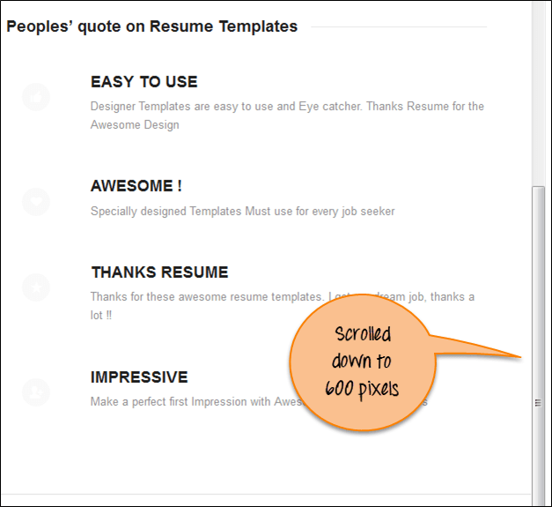
OUTPUT:-

Slide 10
Covered Till Now
JavaScriptExecutor is used when Selenium Webdriver fails to click on any element due to some issue.
JavaScriptExecutor provides two methods "executescript" & "executeAsyncScript" to handle.
Executed the JavaScript using Selenium Webdriver..
Scrolled down the window using JavaScriptExecutor.

Slide 11
Thanks

